Slide 2
Class 5
Perception

Slide 3
Turn video on,
enable mic
What’s your favorite restaurant
within a 20 min radius?

Slide 4
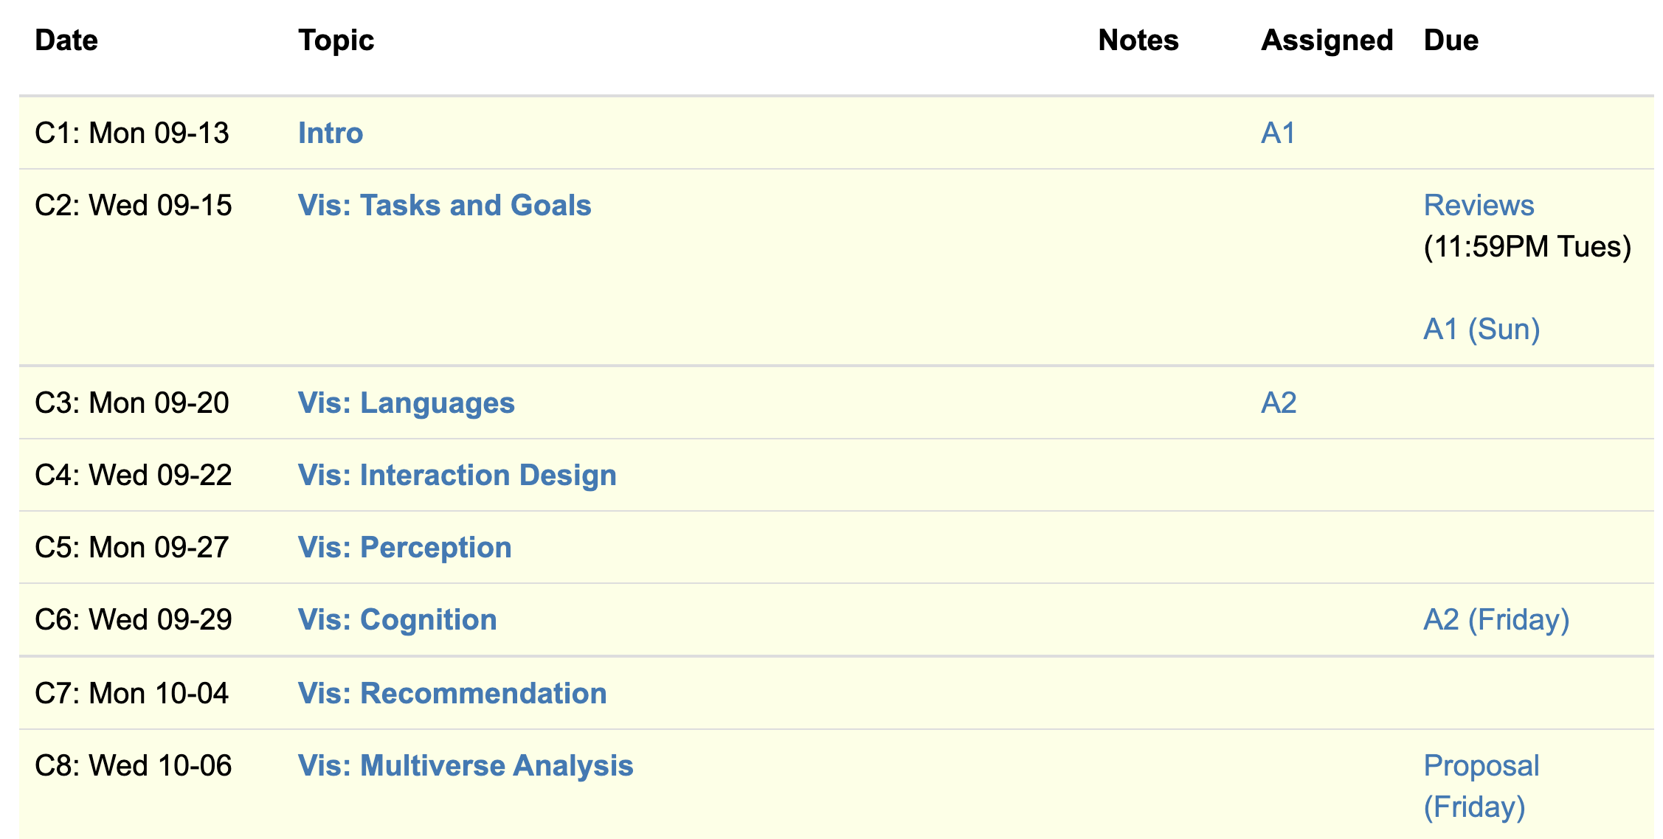
Logistics
A2 due Friday
Think about project proposal. 2 office hours left!

Slide 5
Projects
Build a system
Design an algorithm
Evaluate a design
Study perception/cognition
Survey
Etc.
Some project ideas

Slide 6
Today
Background:
Cleveland & McGill
AMT
Example of another perception experiment
The paper!

Slide 7
How complex?
uh...kind of complex?
Visualization Complexity Score
(this paper)
0.01
0.83
Visual complexity is subjective
Hard to articulate
Notes:
It is clear that the complexity of the chart can affect how easily , and accurately the user can extract information from the chart, at a glance.
We could imagine simplifying or zooming in or smoothing a line chart if it’s too complex, but we need to know that it IS too complex first. But what does complex even mean? Visual complexity can be subjective, and we can’t directy ask users to quantify it for us
This paper proposes ONE possible visualization complexity score, that takes a line chart as input and outputs a score that measures its perceptual complexity. For instance, a lower score for the simple horizontal line, and a higher number of a bunch of squiggles.

Slide 8
Adding Synthetic Noise
Notes:
In this experiment, we start with several simple, representative signals and measure their PAE. We see the line has very very low PAE, and it increases with the complexity of the signal.
We then add random synthetic noise to the signals, and see that the entropy correspondingly increases.
In fact, if we plot the amount of noise on the x axis, and the PAE on the Y axis, we see that there is a very strong correlation
Using this methodology, we find that PAE is correlated with synthetic noise. Now synthetic noise doesn’t necessarily correspond with perceived complexity

Slide 9
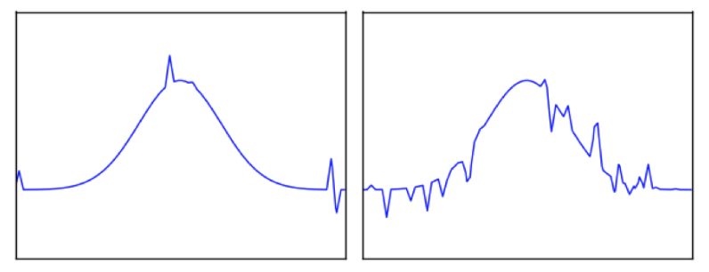
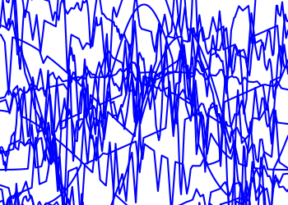
Task: Pick the Original
Glance time
Initial chart shown
Pause time
Mask shown
Pick time
User picks options
Notes:
If you glance over as the visualization changes, can you identify if something changed?
Mask to “clear the perceptual cache” to make sure its due to cognitive rather than low level perceptual pattern matching (after effects)
~3-4 seconds pick time in practice

Slide 10
Ready?
3
2
1

Slide 11
Pick the Original
Accuracy
Reduced
Increased
Change in PAE
Notes:
52 users, randomized order.

Slide 12
Pick the Original
Accuracy
Reduced
Increased
Change in PAE
Initial PAE

Slide 13
Pick the Original
Accuracy
Reduced
Increased
Change in PAE
Initial PAE
Notes:
It’s reminiscent of JND, but is not a formal staircase study
We also evaluated the effects of glance time and the results are reported in the paper.
(H3.1) Entropy of the initial chart (Z = 2.42, p < 0.05);
(H3.2) Magnitude of PAE difference between the two charts (Z = −5.08, p < 0.001);
(H3.3) Sign of the PAE dif- ference between the two charts (Z = −8.06, p < 0.001); and
(H3.4) Baseline function (χ2(3) = 9.32, p < 0.05).
There were 52 participants

Slide 14
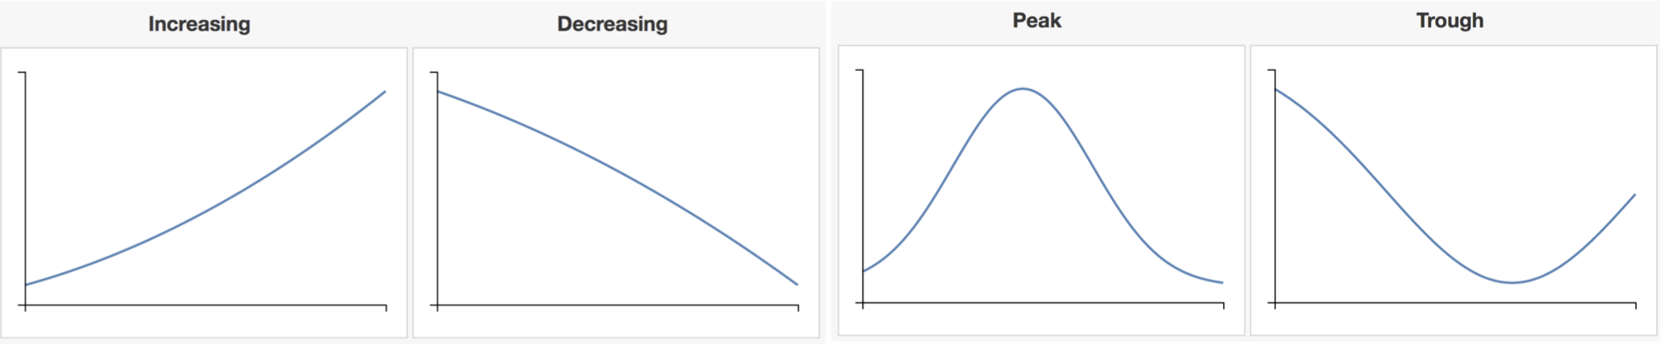
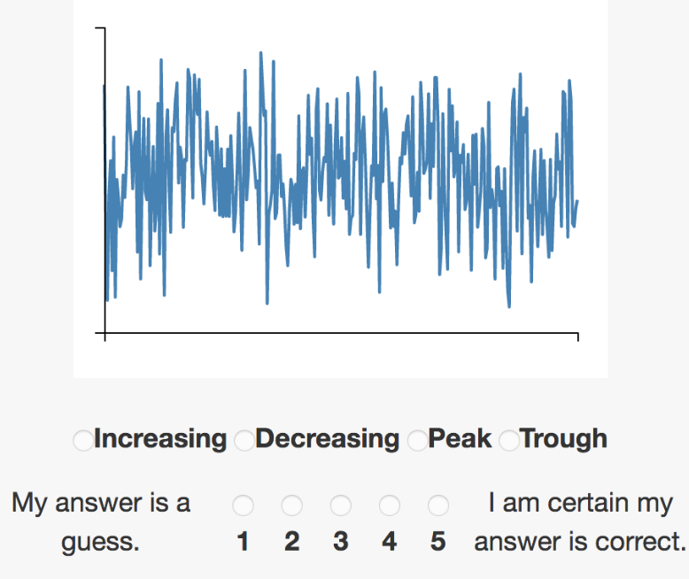
Pick The Signal
Which base function is most representative of chart?
Notes:
500ms glance time (2-4 fixations)
47 total participants,

Slide 15
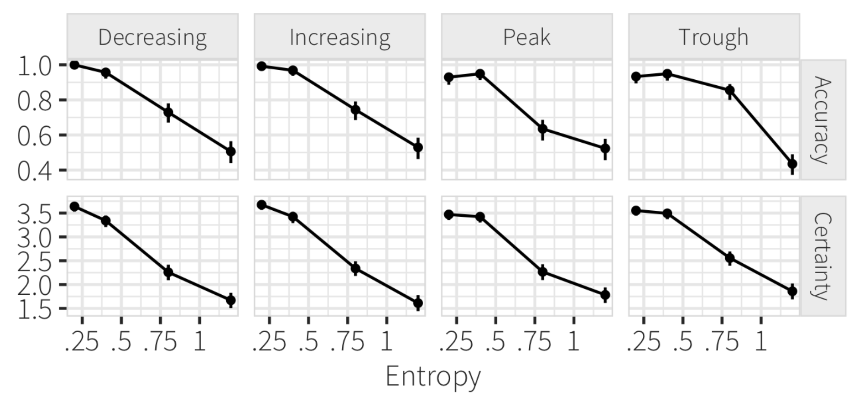
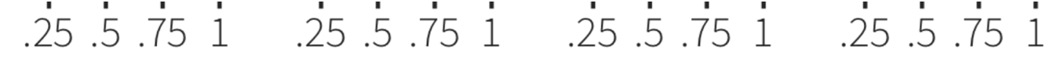
Pick The Signal
PAE
PAE
Notes:
significant results, with clearly high effect size (Z = 25.75, p < 0.001)
For each base function, we showed users 5 versions at each of four PAE levels (0.2, 0.4, 0.8, 1.2), resulting in a 4 × 4 × 5 = 80 factorial design.
There were 47 total participants,

Slide 16
Each group assigns notetaker
What would be a possible follow-up or alternative graphical perception study? Phrase it in the form of a question, and design an experiment for it.
Notes:
How did you pick the other vis language?

Slide 17
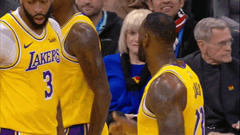
Support your colleagues
for speaking up!

Slide 18
Each group assigns notetaker
What would be a possible follow-up or alternative graphical perception study? Phrase it in the form of a question, and design an experiment for it.

Slide 19
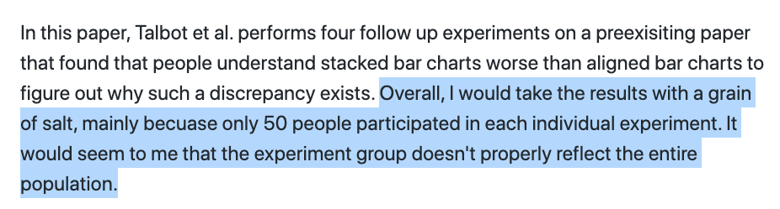

Slide 20
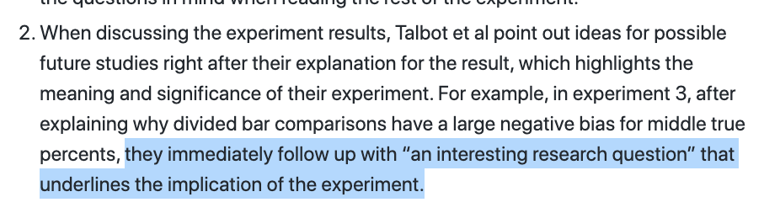

Slide 22
Class 4
Languages, Interaction

Slide 23
Turn video on,
enable mic
Share a book you recently
read/listened to

Slide 24
Logistics
A2 released.
Think about project proposal. 2 office hours left!

Slide 25
Each group assigns notetaker
G1: How does the instrumental interactions model apply to interactive visualizations?
G3, 4: Where do interface languages fit into the instrumental interactions model?
Notes:
How did you pick the other vis language?

Slide 26

Support your colleagues
for speaking up!

Slide 27
Each group assigns notetaker
G1, 2: How does the instrumental interactions model apply to interactive visualizations?
G3, 4: Where do interface languages fit into the instrumental interactions model?

Slide 28
Interactive Interfaces as Domain Specific Languages

Slide 30
Class 3
Languages

Slide 31
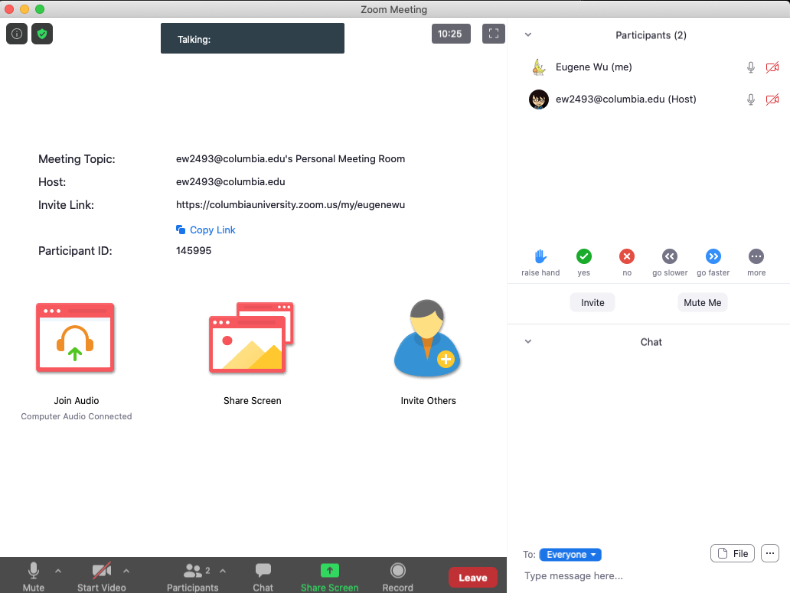

Turn video on,
enable mic & say:
“Hi, this is _(name)_,
I usually eat ________ for lunch”
Click when done
Participants
Chat

Slide 32
Logistics
A1 was due last night
A2 released.

Slide 33
Each group assigns notetaker
G1 and 2: What criteria makes a HDI language good? Put the criteria into action: pick a domain/task and make up a language.
G3 and 4: discuss the strengths and weaknesses of how the paper is communicated. Share the top strength and top weakness.
Notetaker shares what you came up with and the process.
Notes:
How did you pick the other vis language?

Slide 34
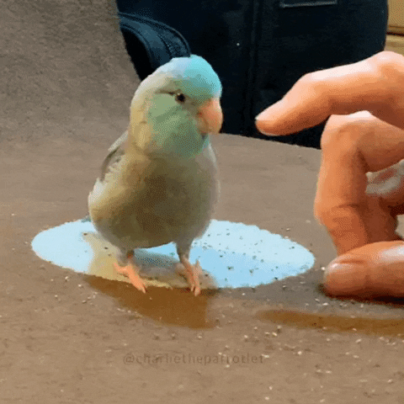
Support your colleagues
for speaking up
A quick thanks or follow up
is great

Slide 35
Each group assigns notetaker
G1 and 2: What criteria makes a HDI language good? Pick a domain/task and come up with a language.
G3 and 4: discuss the strengths and weaknesses of how the paper is communicated. Share the top strength and top weakness.
Notetaker shares what you came up with and the process.

Slide 36
Technique
Is it correct?
Does it make sense?
Is it as simple as possible?
Are decisions unnecessarily complex?

Slide 37
Comunication
What is the appropriate audience?
How well do they justify
Design decisions?
Technical approach?
The problem itself?

Slide 38
Experiments
What SHOULD have been done?
How should it be measured?

Slide 39
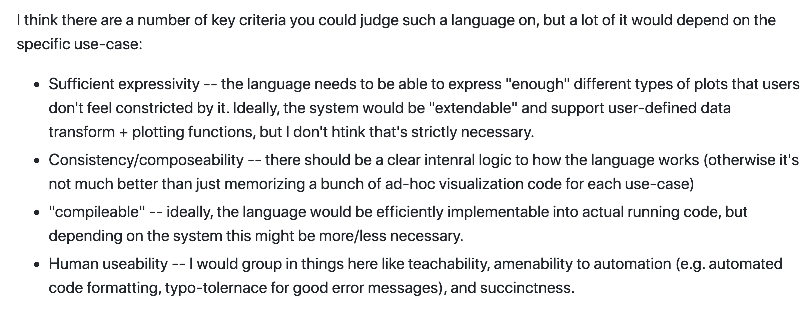

Slide 40
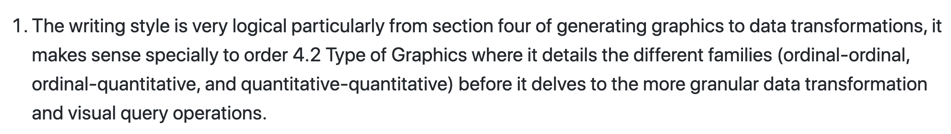

Slide 41
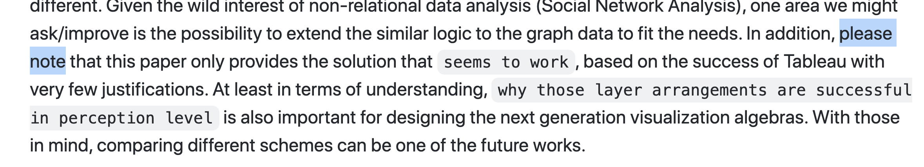

Slide 42
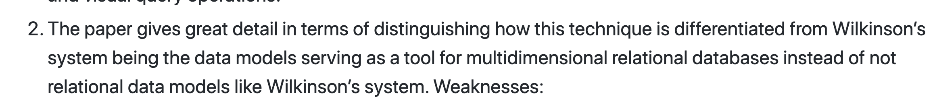

Slide 43
Class 2
Tasks

Slide 44
Discussion prompt:
Recent book that you find memorable

Slide 45


Slide 46
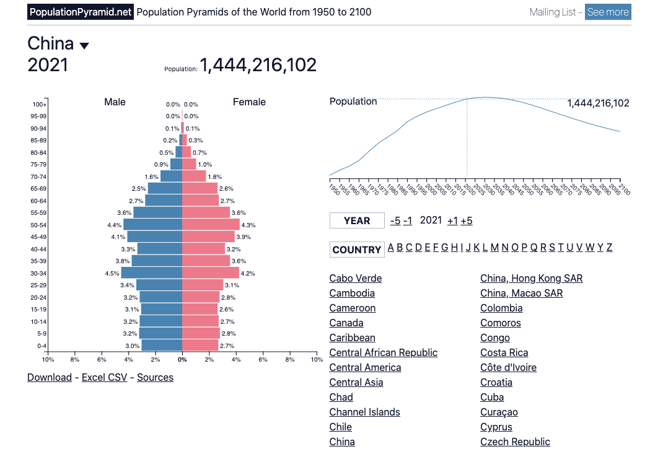

Slide 47
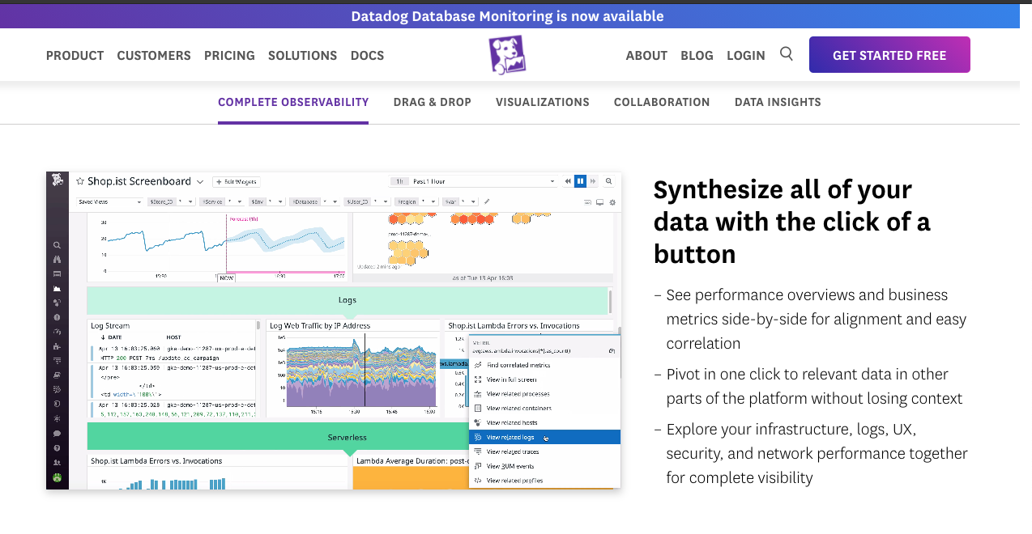

Slide 48
Each group assigns notetaker
Groups of 4:
You back-fitted task descriptions from a visualization. Discuss your process, what made it easy/difficult, and reflect on the applicability of the task typology.
Bonus, choose a visualization and task to share with the class. (connect to zoom, share screen)

Slide 49
Support your colleagues
for speaking up
A quick thanks or follow up
is great

Slide 50
Each group assigns notetaker
Groups of 4:
Discuss and share the visualization and task description you created in the review.
Choose one that notetaker will share with the class
(connect to zoom, share screen)

Slide 51
TODOs
A1!!

